Slide 1
ENGR 12
Dr. Mandala
Notes:
Down

Slide 2
FILE commands
Command | Meaning
FILE | FILE *[filenamevariable]; EXAMPLE: FILE *fdata fdata is a file pointer FILE definition included in <stdio.h> FILE is a type name, like int or char
fopen | fdata = fopen(name, mode); name: a character string containing the name of the file mode: a character string, which indicates how one intends to use the file; allowable modes include read (“r”), write (“w”), and append (“a”)
fclose | fclose(fdata); inverse of fopen breaks the connection between the file pointer (fdata) and the external name that was established with fopen, freeing the file pointer for another file
fscanf | fscanf(fdata, format, arg1, arg2, …); identical to scanf except that the first argument is a file pointer that specifies the file to be read or written
fprintf | fprintf(fdata, format, arg1, arg2, …); identical to printf except that the first argument is a file pointer that specifies the file to be read or written

Slide 3
File Modes
Syntax: variable_file_pointer = fopen (“filepath”,”mode”);
Mode | Description
r | Read mode only. If file exist, it opens file to read. Does not write to storage. If file does not exist, returns NULL.
w | Write mode only. If file exists, it erases current data. Writes new data to storage. If file does not exist, creates a new file.
a | Append mode only. If file exists, it opens file. Writes new data to end of file in storage. If file does not exist, creates a new file.
r+ | Read and write mode. If file exists, it opens file to read. Erases current data and writes new data to storage. If file does not exist, returns NULL.
w+ | Similar to r+ Only difference: If file does not exist, creates a new file.
a+ | Similar to w+ Only difference: read occurs from beginning of file, write occurs at end of current data
rb,rb+,wb, wb+,ab,ab+ | Corresponding modes for binary files

Slide 4
As a team
Ask the user if he/she wants to display the file data in data.dat.
If yes, display the file data on screen
If no, ask the user to enter a name and append this value to the file. Additionally, append the following numbers and exit.
45 45
<Solution on next slide>
Notes:
Data.dat contains:
1 2
2 4
3 6
4 8
5 10
6 12
7 14
8 16
9 18
10 20
11 22
12 24
13 26
14 28
15 30
16 32
17 34
18 36
19 38
20 40

Slide 5
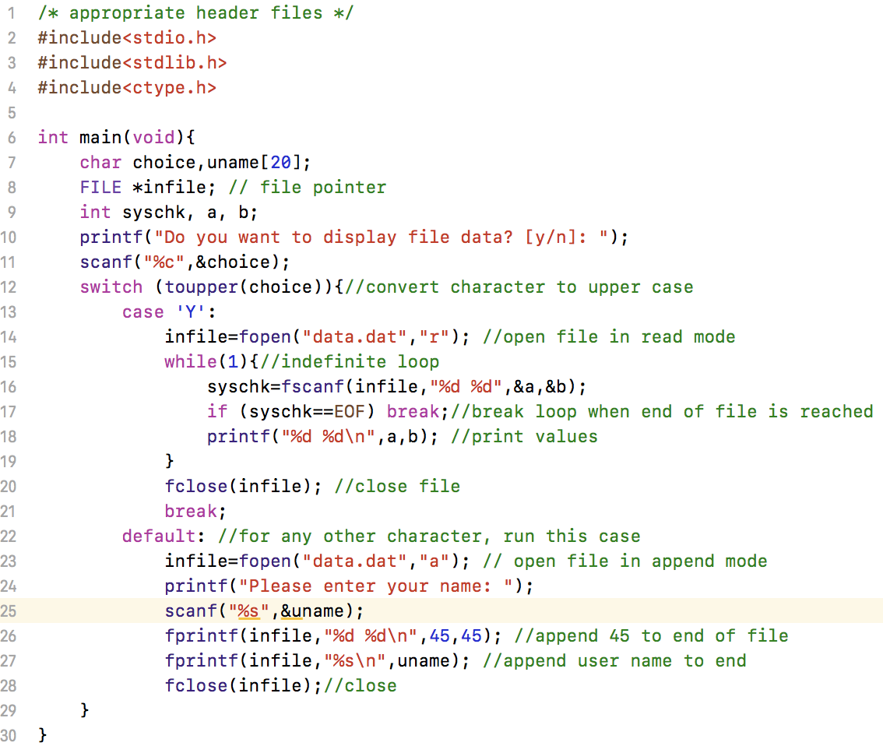
Append data to file

Slide 6
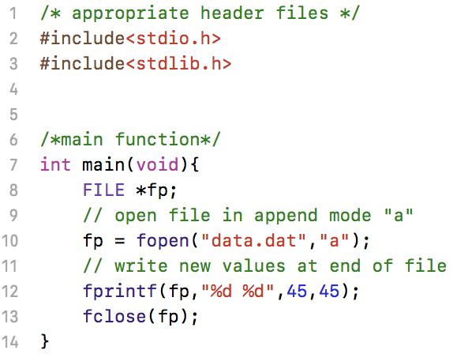
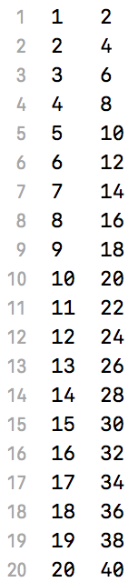
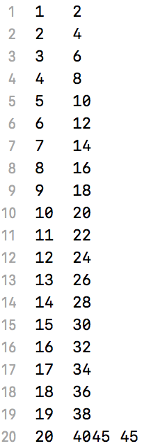
Appending an existing file
Original: data.dat
Appended: data.dat
Data appended at end of last character in data.dat.
To add data on new line, use:
fprintf(fp,”\n%d %d”,45,45);

Slide 7
Functions
Default: returns an integer
If specified in prototype returns value of data type of function:
float foo(int a) ; returns a float
char foo (void) ; returns a char
int foo(char, int, float); returns a int
foo(void); returns a int
Can return only one value or return no value at all (void).
Can accept no value or as many as specified.

Slide 8
As a team
Write C code using functions:
Main function
Display your name on screen
Create a 1-D array of 20 integers
Call uservalue function to accept user entered numbers (cannot exceed 20)
Display the 1-D array
Repeat loop as many times as needed (use userchoice function to accept user choice)
uservalue
Accept no value, return user entered value
userchoice
Accept no value, return user entered value
<Solution on next slide>

Slide 9
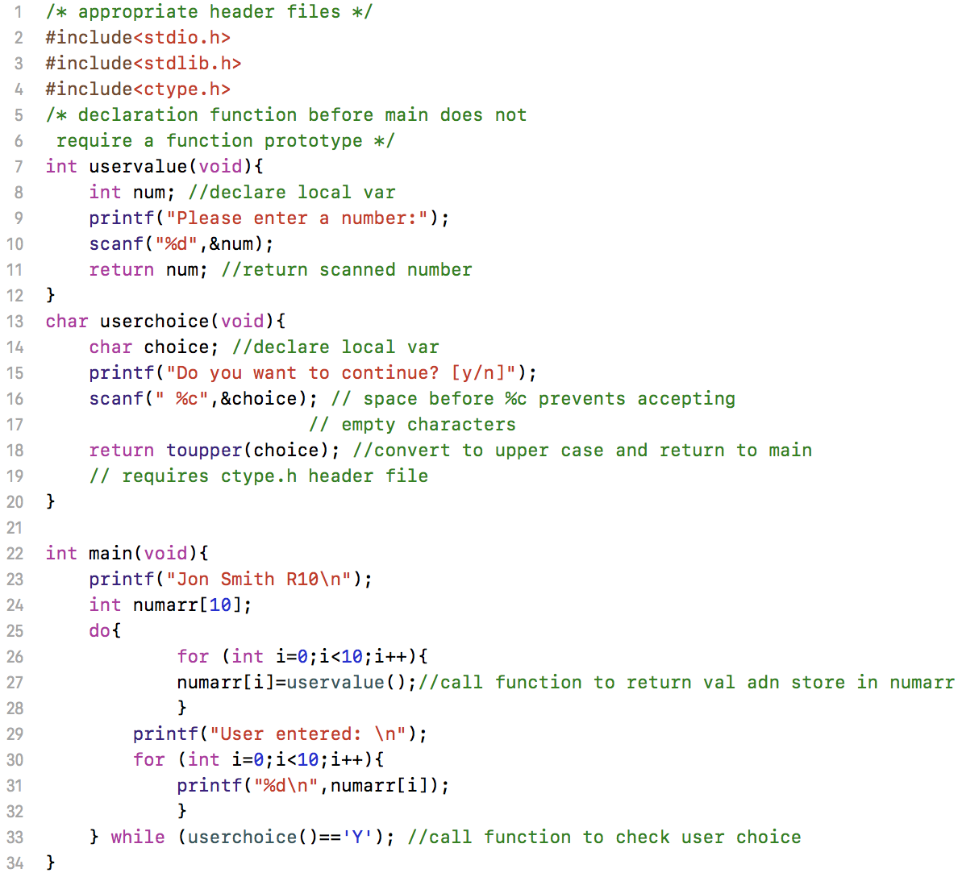
Solution

Slide 10
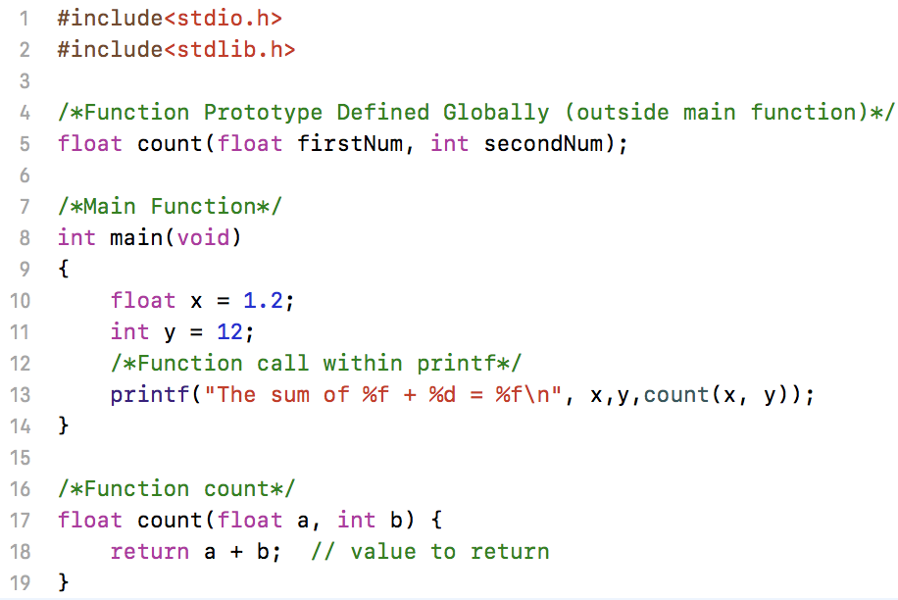

Functions
Function definition: Lets compiler know that a function of this syntax exists to set rules for its use.
Variable names are optional in definition, their types are not.
float count(float, int);
Function calls can be made within scope of the function definition. Here function was defined outside of main(): it is a global function i.e. any code written in this file can access it!
Function declaration should contain the variables to be used within it.
return command returns the value back to its caller.

Slide 11
Summary
Functions can only return one value
To return more than one, you need to use address variables/pointers.
Functions can return values of type:
int
float
char
struct
void (no value returned)
* (address variables/values)
Functions can accept any number of variables of all supported C datatypes.

